Slide 1


Unit 6 – ARIMA
Scott Frazier

Slide 2
Day 1 Time Series – Which model is appropriate?
Looking at the original time series data for female births, it appears that an ARUMA model may be our best option here since we are seeing elements that appear seasonal.
We would expect slightly/ slowly damping ACF values for a good ARIMA fit, but instead we are seeing very sudden damping, as well as sinusoidal behavior, indicating cyclic characteristics.

Slide 3
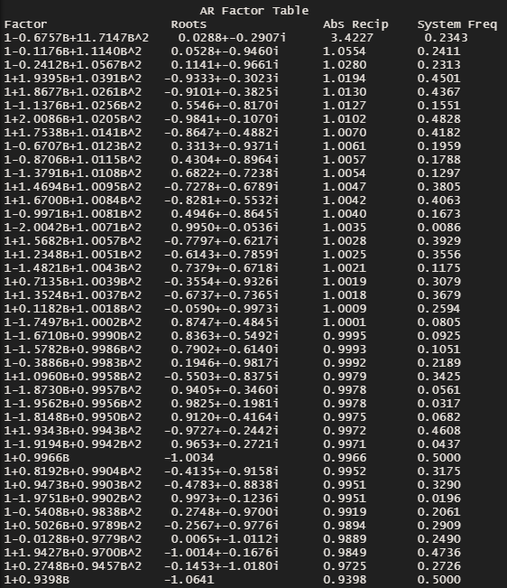
Seasonal Model – S = 7

Slide 4

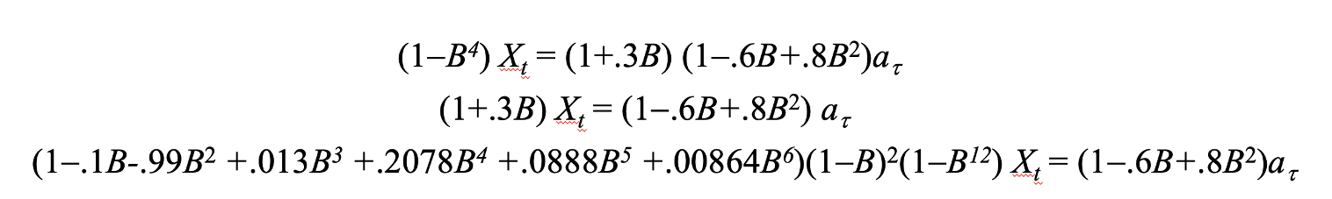
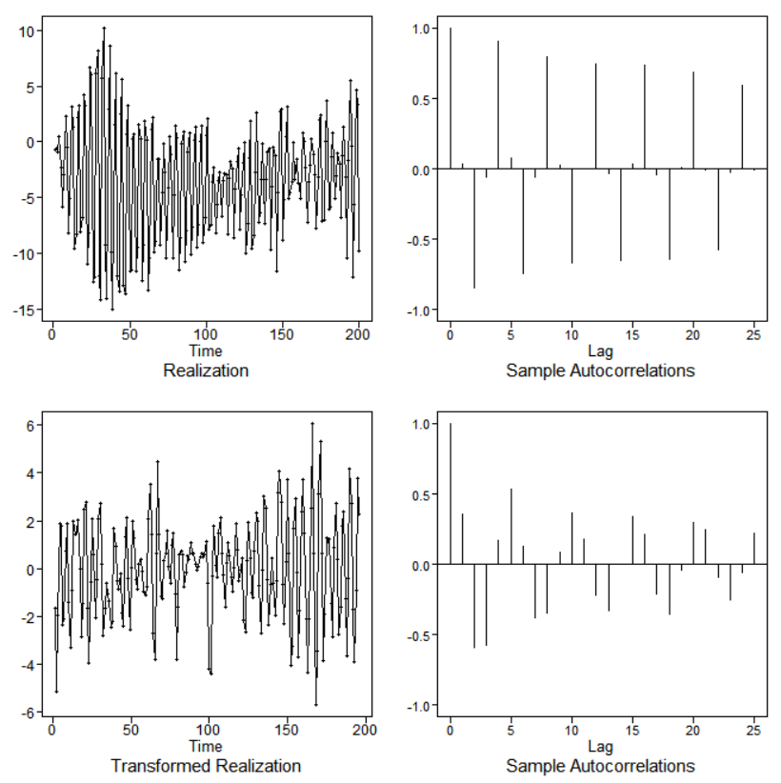
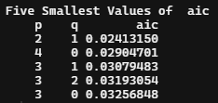
Choosing models
Looking at the original realization in the top left, we see data the would indicate a model which is not stationary. We do not have a constant mean, or constant variance.
Because of this, the difference was taken to attempt and stationarize the model. We are still seeing sinusoidal-oscillating behavior though. This model may be a good fit for

Slide 5

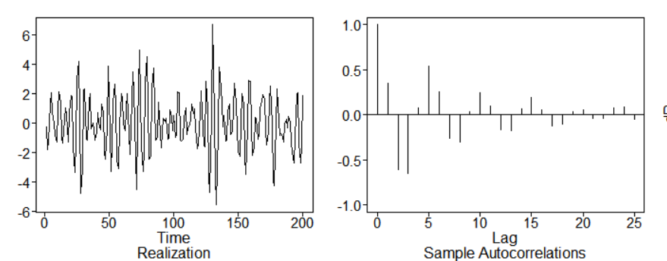
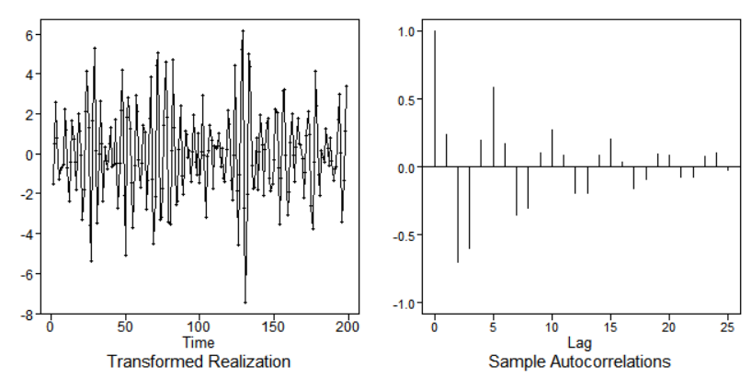
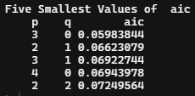
Choosing models
Looking at the realizations to the right, we see that the two realizations are not very different from one another. Differencing did not seem to make much of a change here.
I am a bit confused at this point so I am going to say the model is an ARMA(2,1), this being because we did not see a drastic change after differencing.

Slide 6
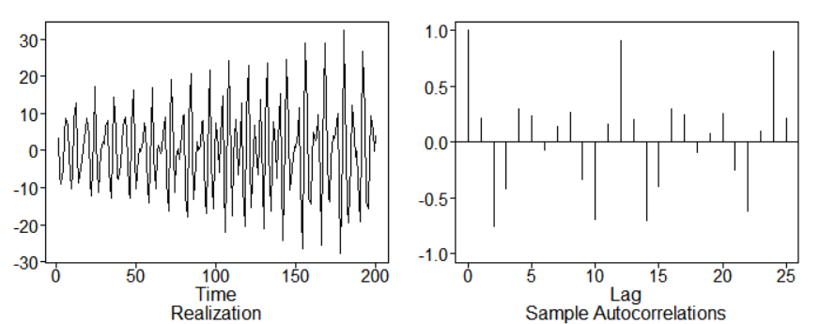
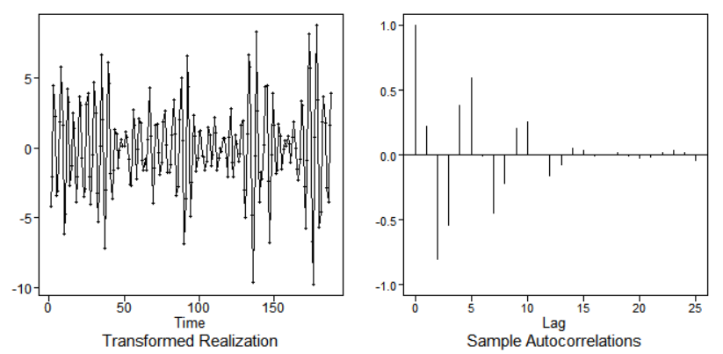
Choosing models
I would say this model would best perform with an ARUMA model because it seems as if we are dealing with some slightly seasonal data.

Slide 7

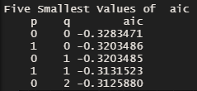
American Airlines Stock Data
Looking at the AIC results which give us an idea of the structure of the data now that we have taken the difference, we can see that the lowest AIC value would be p = 0, q = 0. So with this in mind, a seasonal ARUMA model would perhaps be a best fit for this data which is dealing with daily “close” values for the AAL stock.

Slide 8
Takeaways
ARUMA models are useful for dealing with seasonal data.
ARIMA models are useful when we need to seek the use of differencing because a model is not stationary and not fit to be an ARMA model.

Slide 9
Questions
How do we tell which AIC5 correlation structure is preferred with ARIMA models? With the ARMA models, it was the one with the lowest value, correct? That does not seem to be the case here, and I am a bit confused.
Also relating to the question above, is the best model different based on if we are using the first/ second difference?
Overall, I am a bit confused on how to tell when we should be using ARIMA vs ARUMA models.
How do we know when we have taken the difference enough times when working with ARIMA/ARUMA models?

